Slide 1
UNIT II
CLOUD ARCHITECTURE AND MODEL
Technologies for Network Based system - System Models for Distributed and Cloud Computing - NIST Cloud Computing Reference Architecture Cloud models: Characteristics - Cloud Services - Cloud Models (IaaS, PaaS, SaaS) - Public vs. Private Cloud - Cloud Solutions - Cloud ecosystem - Service Management - Computing on demand

Slide 2
Technologies for Network Based System (12 Marks)
Network-based systems rely on various technologies to enable communication, resource sharing, and data exchange across multiple devices and platforms. Here are key technologies that are fundamental to network-based systems:
1. Networking Protocols
TCP/IP (Transmission Control Protocol/Internet Protocol): This is the fundamental protocol suite for internet and local area networks. TCP ensures reliable data transmission, while IP handles addressing and routing.
HTTP/HTTPS (Hypertext Transfer Protocol / Secure HTTP): Used for transferring web pages and data over the internet, HTTPS adds encryption to secure the communication.
FTP/SFTP (File Transfer Protocol / Secure FTP): Allows file transfer between a client and server. SFTP adds encryption for secure transfers.
DNS (Domain Name System): Converts human-readable domain names into IP addresses, enabling browsers to locate servers on the internet.
SMTP/POP/IMAP: Protocols for email transmission (SMTP) and retrieval (POP/IMAP).

Slide 3
2. Network Devices
Routers: Direct data between different networks, ensuring that packets are routed to their intended destinations.
Switches: Connect multiple devices within a network and manage the data flow efficiently.
Firewalls: Protect networks by monitoring and controlling incoming and outgoing traffic based on security rules.
Load Balancers: Distribute incoming traffic across multiple servers to ensure no single server is overwhelmed, improving redundancy and availability.
Example: Amazon Web Services (AWS) Elastic Load Balancer automatically routes traffic across multiple servers in different regions. For instance, during Black Friday sales, e-commerce platforms like Shopify use this to handle surges in traffic smoothly.

Slide 4
3. Wireless and Wired Communication Technologies
Wi-Fi (802.11 standards): Wireless networking technology allowing devices to connect to the internet or local network without cables.
Ethernet (802.3 standards): A wired technology commonly used for connecting devices in local area networks (LANs).
Bluetooth: Wireless technology for short-range communication between devices, often used for peripherals and IoT devices.
5G/4G LTE: Mobile network technologies enabling high-speed internet access over cellular networks, important for IoT and mobile devices.

Slide 5
4. Cloud Computing
IaaS (Infrastructure as a Service): Providers like AWS, Azure, and Google Cloud offer computing resources such as virtual machines, storage, and networking components.
PaaS (Platform as a Service): Platforms that allow developers to build and deploy applications without worrying about the underlying infrastructure.
SaaS (Software as a Service): Software delivered over the internet, such as Google Workspace or Microsoft 365, eliminating the need for local installation

Slide 6
5. Virtualization and Containerization
Virtual Machines (VMs): Allow multiple operating systems to run on a single physical machine, each acting as a separate environment.
Containers (Docker, Kubernetes): Containers package an application and its dependencies together, ensuring it runs the same way across different environments. Kubernetes helps manage and orchestrate containers at scale.
Kubernetes will:
Managing communication between microservices.
Seamless connectivity within clusters, enabling scalable and resilient applications in the cloud.
Indispensable for businesses adopting DevOps and microservices architectures.
Example : Spotify uses Kubernetes to manage its music-streaming services. As users listen to songs, Kubernetes ensures microservices like recommendation algorithms and search features communicate efficiently, scaling up resources as demand rises.

Slide 7
6. Data Storage and Database Systems
SQL/NoSQL Databases: SQL databases like MySQL and PostgreSQL are used for structured data, while NoSQL databases like MongoDB and Cassandra are used for unstructured or semi-structured data.
Distributed File Systems (HDFS, Ceph): Systems that allow storage across multiple machines, providing redundancy and scaling for large amounts of data.
Network Attached Storage (NAS) and Storage Area Networks (SAN): NAS provides shared file storage, while SAN is a high-speed network that connects storage devices to servers.

Slide 8
7. Network Security Technologies
Encryption (TLS/SSL): Ensures data is transmitted securely over the network, with SSL/TLS providing secure encryption for HTTPS websites.
VPN (Virtual Private Network): Provides secure, encrypted connections over public networks, allowing remote users to securely access internal network resources.
IDS/IPS (Intrusion Detection/Prevention Systems): Monitors network traffic for suspicious activity and can take action to prevent security breaches.
Secure access service edge (SASE), and zero-trust network access (ZTNA) ensure robust security for cloud-based systems. These tools protect against evolving cyber threats, ensuring data integrity and compliance with regulatory standards.
Example Cloudflare uses Secure Access Service Edge (SASE) to protect websites from Distributed Denial-of-Service (DDoS) attacks.
For example, e-commerce platforms like Etsy use Cloudflare to ensure their online stores remain operational during cyberattacks.

Slide 9
8. Middleware and Distributed Systems
Message Queuing (MQ, RabbitMQ, Kafka): These technologies handle communication between different components of distributed systems by queuing messages to ensure reliable and scalable data transfer.
Microservices Architecture: This is a method of developing software systems as a collection of small, independent services that communicate over a network.
Remote Procedure Calls (RPC) and APIs (REST, GraphQL): Enable applications to request services from other software located on different machines within the network.

Slide 10
9. Network Management Tools
SNMP (Simple Network Management Protocol): Used for collecting and organizing information about managed devices on IP networks and modifying device behavior.
Network Monitoring Tools (e.g., Nagios, Zabbix): Monitor network performance and availability, alerting administrators to issues like downtime or slow traffic.
SDN (Software-Defined Networking): Allows network administrators to manage and program network behavior dynamically through software interfaces rather than hardware configurations. SDN allows for centralized management and programmability of network infrastructure through software, offering increased flexibility, scalability, and automation in cloud environments.
Example: Google’s B4 SDN is a private WAN connecting its data centers worldwide. SDN helps Google optimize network bandwidth, ensuring efficient use of resources and reducing latency for services like Google Search and YouTube.

Slide 11
10. Edge Computing and Content Delivery Networks (CDNs) and IoT (Internet of Things)
Edge Devices: Computing done closer to where the data is generated (e.g., on IoT devices), reducing latency and bandwidth use. Complementing this, CDNs distribute content across multiple servers globally, enabling faster content delivery and improved user experiences.
IoT Platforms (e.g., AWS IoT, Azure IoT): Enable devices to connect, manage, and secure data exchange across various connected devices in a network.
These technologies form the foundation of modern network-based systems, enabling global connectivity, efficient resource sharing, and secure communication across devices and users.
Example: Netflix uses CDNs like Akamai to stream videos seamlessly worldwide. By caching popular shows closer to users, buffering is minimized. Similarly, edge computing supports smart cities by processing real-time traffic data for navigation systems like Google Maps.

Slide 12
Automation and Artificial Intelligence (AI)
Automation and AI are transforming network management in cloud computing. AI-driven analytics optimize network performance, predict failures, and enhance security through anomaly detection. Automation simplifies repetitive tasks, such as configuration and monitoring, enabling efficient management of complex cloud networks.
Example: Cisco’s AI-based network automation tool, DNA Center, predicts and resolves network issues before users notice them. For cloud environments, it ensures uninterrupted operation of apps like Slack or Zoom during peak usage.

Slide 13
2. System Models for Distributed and Cloud Computing: (12 Marks)
In distributed and cloud computing, various system models are utilized to manage and facilitate the allocation of resources, communication, and execution of tasks across multiple interconnected devices or nodes.
Here are some key system models:
1.Client-Server Model:
This model involves clients, which initiate requests, and servers, which respond to those requests.
Clients and servers can be distributed across a network, and this model is commonly used in cloud computing where clients access services hosted on remote servers.
Examples: Web browsers interacting with web servers, email clients fetching messages from email servers.
Characteristics: Clients initiate communication; servers respond and serve multiple clients simultaneously.

Slide 14
2.Peer-to-Peer (P2P) Model:
In this model, nodes (peers) in the network act both as clients and servers, sharing resources directly with each other.
P2P networks don’t have a centralized server, and each node contributes to the overall network by sharing its resources.
Examples: File-sharing systems like BitTorrent, distributed blockchain networks.
Characteristics: Decentralized, scalable, and often fault-tolerant since no single node is central.
3.Three-Tier Architecture:
Often used in web applications, this model divides the application
into three interconnected tiers:
presentation tier (client interface),
application tier (logic and processing), and
data tier (storage).
It helps in scalability, as each tier can be scaled independently.

Slide 15
4.Microservices Architecture:
This is an architectural style where an application is built as a collection of loosely coupled services.
Each service is independently deployable and scalable, enabling agility and flexibility in development and deployment.
Examples: Modern cloud applications such as Netflix, Amazon, or other cloud-native solutions.
Characteristics: Highly scalable and maintainable, as each microservice can be updated or scaled independently.

Slide 16
5.Containerization:
Containerization models, like Docker and Kubernetes, encapsulate applications and their dependencies into containers. This allows for consistent deployment across different environments and helps manage applications in distributed systems.
6.Service-Oriented Architecture (SOA):
In SOA, software components provide services to other components via a communication protocol over a network.
Services in SOA are designed to be reusable and loosely coupled.
7.Serverless Computing:
This model abstracts the infrastructure management from developers, allowing them to focus solely on writing and deploying code.
Developers only pay for the resources consumed by their code during execution, rather than maintaining an entire server.

Slide 17
8.Edge Computing:
➢This model brings computation and data storage closer to the location where it is needed, reducing latency and bandwidth usage by processing data closer to the source or end-users, rather than relying solely on centralized cloud servers.
Each of these models has its own advantages and is suitable for specific scenarios and requirements in distributed and cloud computing environments.

Slide 18
NIST Architecture in Cloud Computing: (12M)
The NIST (National Institute of Standards and Technology) cloud computing reference architecture focuses on the requirements of “what” cloud services provide, not a “how to” design solution and implementation.
The reference architecture is intended to facilitate the understanding of the operational intricacies in cloud computing.
The NIST’s Cloud Computing Architecture Model
The National Institute of Standards and Technology (NIST) has defined a comprehensive cloud computing architecture model that outlines various components and their interactions within a cloud environment. This model is described in the NIST Special Publication 500-292, known as the NIST Cloud Computing Reference Architecture.

Slide 19
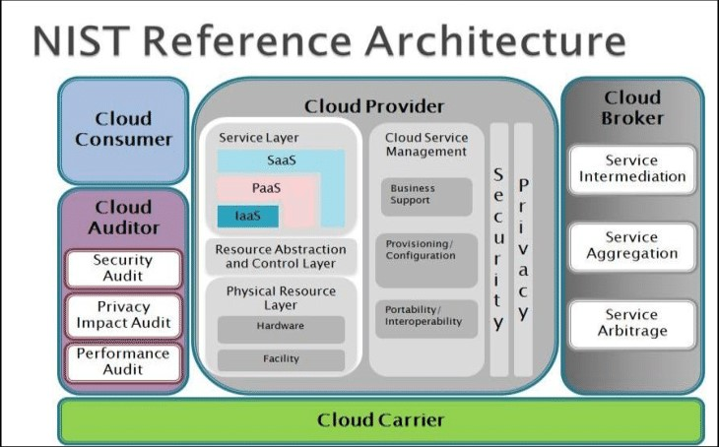

Slide 20
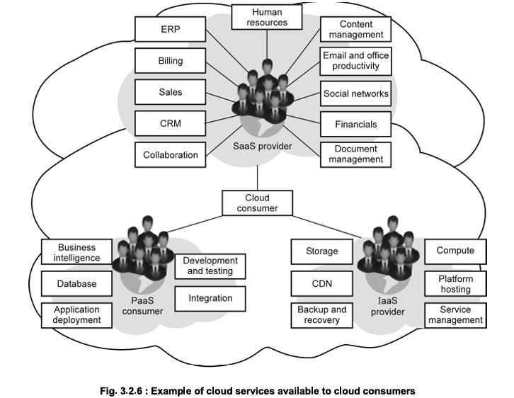
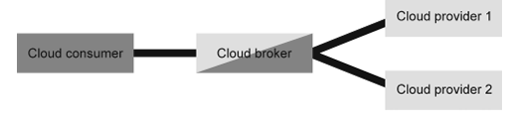

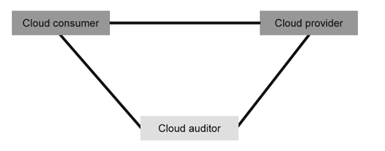
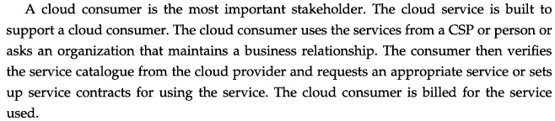
Cloud Service Consumer:

Slide 21
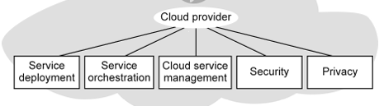
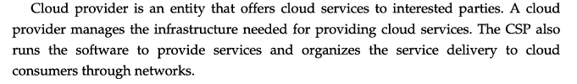
Cloud Service Consumer:
Represents entities or individuals who use cloud services. Consumers can be individuals, businesses, or other systems that access and utilize cloud services. SLA – Service Level Agreement
Cloud Provider:
Offers cloud services and resources to cloud service consumers. This provider can be a public, private, or hybrid cloud provider and manages the underlying infrastructure and services.

Slide 22
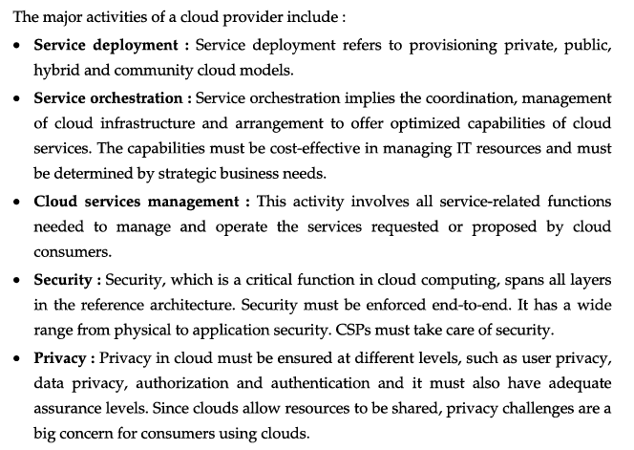

Slide 23
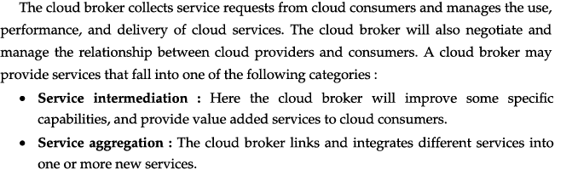

Cloud Broker:
Acts as an intermediary between cloud service providers and consumers, facilitating the selection,
integration, and management of cloud services from multiple providers.
The broker enhances interoperability and provides added value to consumers.

Slide 24
Cloud Auditor:
Assesses and verifies cloud services, operations, performance, and security.
The cloud auditor ensures compliance, governance, and adherence to established policies and regulations.
Cloud Carrier:
Provides connectivity and transport of cloud services between consumers and providers.
This may include telecommunications networks, internet service providers (ISPs), and other network infrastructure.

Slide 25
Cloud Consumers in the NIST Cloud Computing Reference Architecture
NIST designates Cloud Consumers as the principal stakeholders for cloud computing services.
The category includes three Cloud Consumer distinctions according to the services used:
Software as a service (SaaS) consumers who rely on cloud computing for general office or productivity services (e.g., HR and accounting tasks)
Platform as a service (PaaS) consumers who rely on cloud computing for their business intelligence needs (e.g., database management and application integration)
Information technology as a service (ITaaS) consumers who rely on cloud computing for IT needs (e.g., storage, backups, content delivery, and other general computing tasks)

Slide 26
Orchestration in the NIST Cloud Computing Reference Architecture:
The second Architectural Component is Orchestration, which refers to three hierarchical layers of system components that providers require to deliver services:
Service layer – This layer determines service type, corresponding to the SaaS, PaaS, and ITaaS categories of providers.
Resource abstraction and control – This layer determines the internal software assets and systems needed to abstract data (e.g., virtual machines) and those needed for control (e.g., dynamic allocation) to communicate with system hardware.
Physical resource layer – This layer concerns physical resources (e.g., endpoints, servers)

Slide 27
Management in the NIST Cloud Computing Reference Architecture
The third Architectural Component is Management, which breaks down into three categories:
General business support – Cloud-based management of business processes (e.g., client, inventory, contract management, accounting, and reporting)
Provisioning / configuration – Cloud-based management of logistical processes (e.g., deployment or adjustment of cloud systems or service-level agreements)
Portability / interoperability – Cloud-based management of information-related tasks (e.g., optimization across various formats and wide-scale security and accessibility)

Slide 28
NIST’s Five Characteristics of Cloud Computing 4M
The five essential characteristics of a cloud service create the cloud computing infrastructure. It includes a physical layer of hardware resources and an abstraction layer which consists of the software deployed across the physical layer. These attributes are:
1. On-Demand Self-Service
Self-service means that the cloud user can acquire the service independently: without going through an IT department, call center, or other middle man. To support self-service:
The cloud provider must have an automated interface, such as a web portal or mobile app.
The user should be able to access the interface at any time.
The user should also be able to cancel the cloud service at any time.

Slide 29
2. Broad Network Access
The cloud service must be broadly available over the communication network. Users should be able to access it from any location and internet-enabled device.
3. Resource Pooling
Multiple customers share the cloud service resources in a multi-tenancy model.
This model raises privacy and security concerns, so users must protect their cloud data and assets by taking necessary security precautions.
4. Rapid Elasticity
✓Elasticity refers to the flexibility of the cloud service to scale up or down automatically to meet the user’s needs.
✓That allows the user to access the right level and kind of resources, including processing power, memory, network bandwidth, and storage, to accommodate the user’s varying workloads.
5. Measured Service
A measured cloud service provides a metering capability that underpins the provider’s pay-as-you-go pricing model.
This model provides users with greater transparency and control over their cloud costs.

Slide 30
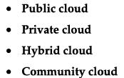
Cloud Models
Cloud computing is a model for enabling ubiquitous, convenient, and on-demand network access to a shared pool of resources. These computing resources can be rapidly provisioned and released with minimal effort.
Cloud Service models
➢SaaS (Software as a Service)
➢IaaS (Infrastructure as a Service)
➢PaaS (Platform as a Service)
Cloud Deployment Models: (Who Controls/ Where Infrastructure Reside)

Slide 31
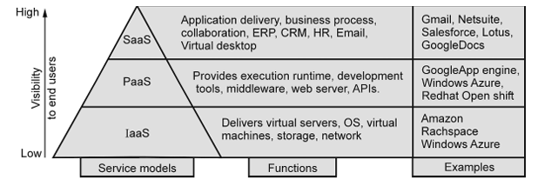
IaaS (Infrastructure as a Service):
IaaS provides virtualized computing resources over the internet. It delivers fundamental computing infrastructure like virtual machines, storage, and networking. Users have control over operating systems, storage, and deployed applications, but they don't manage the underlying hardware.
Example: Amazon Web Services (AWS) EC2, Microsoft Azure Virtual Machines, Google Compute Engine.

Slide 32
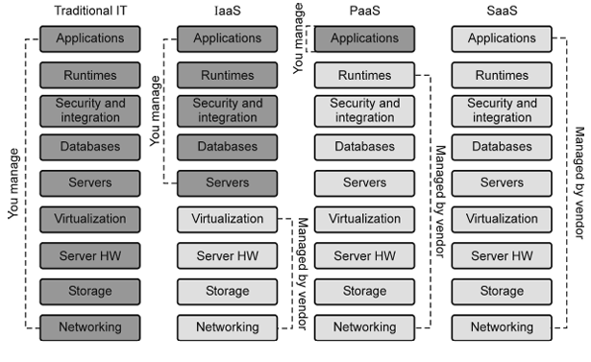

Slide 33
PaaS (Platform as a Service):
PaaS offers a platform allowing customers to develop, run, and manage applications without dealing with the complexity of building and maintaining the underlying infrastructure. It provides an environment for developers to build upon, often including development tools, databases, middleware, etc.
Example: Heroku, Google App Engine, Microsoft Azure App Service.

Slide 34
3. SaaS (Software as a Service):
SaaS delivers software applications over the internet on a subscription basis. Users access these applications through a web browser without needing to install or manage the software. The provider manages everything from data, servers, and software updates.
Example: Google Workspace (formerly G Suite), Microsoft 365, Salesforce, Dropbox.
Each model offers different levels of control and management, catering to various user needs. IaaS provides the most control over infrastructure, while SaaS offers the least control but the most convenience. PaaS sits in between, focusing on application development and deployment without managing infrastructure concerns.

Slide 35
Deployment in the NIST Cloud Computing Reference Architecture
The first Architectural Component is Deployment, which follows one of four distinct models:
▪Public – Most cloud infrastructure and resources are available or accessible to a diverse audience, including the general public and a wide range of subscription-level consumers.
▪Private – The cloud infrastructure and resources are available or accessible to only an individual consumer. These are hosted on-site by the provider or off-site by a third party.
▪Community – Most cloud infrastructure and resources are available or accessible to a group of consumers within the same industry or with similar security needs or concerns.
▪Hybrid – Cloud infrastructure and resources are available via distinct, packaged distribution models (e.g., through a cloud broker).

Slide 36
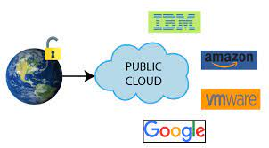
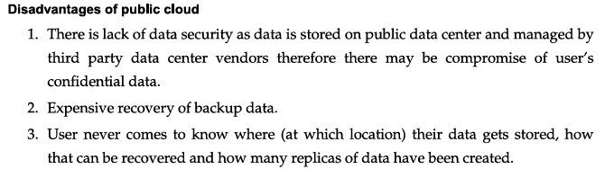
What is a public cloud?
Public cloud is a type of computing where resources are offered by a third-party provider via the internet and shared by organizations and individuals who want to use or purchase them. Managed by Cloud Service Providers (CSP)/ CSB Brokers. Runs over Internet connection.
Amazon web services, Microsoft Azure, Google app engine and Salesforce

Slide 37
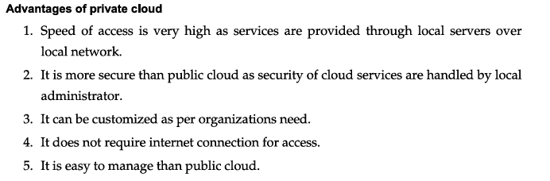
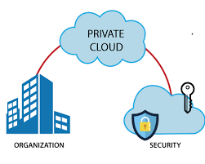
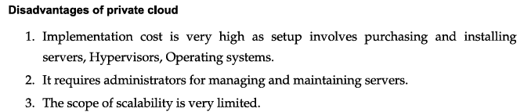
What is Private Cloud?
A private cloud is a cloud computing environment that's exclusively used by a single organization. It's also known as a corporate or internal cloud and runs over an intranet connection

Slide 38
Public Cloud | Private Cloud
Cloud Computing infrastructure is shared with the public by service providers over the internet. It supports multiple customers i.e, enterprises. | Cloud Computing infrastructure is shared with private organizations by service providers over the internet. It supports one enterprise.
Multi-Tenancy i.e, Data of many enterprises are stored in a shared environment but are isolated. Data is shared as per rule, permission, and security. | Single Tenancy i.e, Data of a single enterprise is stored.
Cloud service provider provides all the possible services and hardware as the user-base is the world. Different people and organizations may need different services and hardware. Services provided must be versatile. | Specific services and hardware as per the need of the enterprise are available in a private cloud.
It is hosted at the Service Provider site. | It is hosted at the Service Provider site or enterprise.
It is connected to the public internet. | It only supports connectivity over the private network.

Slide 39
Scalability is very high, and reliability is moderate. | Scalability is limited, and reliability is very high.
Cloud service provider manages the cloud and customers use them. | Managed and used by a single enterprise.
It is cheaper than the private cloud. | It is costlier than the public cloud.
Performance is low to medium. | Performance is high.
Example: Amazon web service (AWS) and Google AppEngine etc. | Example: Microsoft KVM, HP, Red Hat & VMWare etc.

Slide 40
Cloud Solutions:
Cloud solutions encompass a wide array of services, tools, and technologies hosted and delivered over the internet by cloud computing providers.
These solutions cater to various business needs, enabling organizations to access computing resources, storage, applications, and more without the necessity of maintaining their own infrastructure.
Here are some key categories of cloud solutions:
Infrastructure Solutions:
Infrastructure as a Service (IaaS): Provides virtualized computing resources like servers, storage, and networking. Users can scale resources as needed, paying for what they use.

Slide 41
Platform Solutions:
Platform as a Service (PaaS): Offers a platform allowing developers to build, deploy, and manage applications without managing the underlying infrastructure.
Software Solutions:
Software as a Service (SaaS): Delivers software applications over the internet on a subscription basis, eliminating the need for local installation or maintenance.
Storage Solutions:
Cloud Storage: Provides scalable and accessible storage solutions for businesses to store and retrieve data.
Database Solutions:
Cloud Databases: Managed database solutions that offer scalability, reliability, and ease of use for storing and managing data.

Slide 42
Cloud Service Management? 4M
The management of cloud infrastructure products and services is cloud management. Public clouds are operated by public cloud service providers, which provide the servers, storage, networking and data centre operations of the public cloud environment. With a third-party cloud management tool, users can also choose to manage their public cloud services.
Public cloud service users can typically choose from three categories of specific cloud provisioning:
User self-provisioning: Users, usually via a web form or console interface, buy cloud services directly from the provider. On a per-transaction basis, the client pays.
Advanced provisioning: A pre-determined sum of services scheduled in advance of operation is contracted in advance by customers. A flat fee or a monthly fee is charged by the consumer.
Dynamic provisioning: When the client requires them, the provider allocates resources, and then decommissions them when they are no longer required. On a pay-per-use basis, the client is paid.

Slide 43
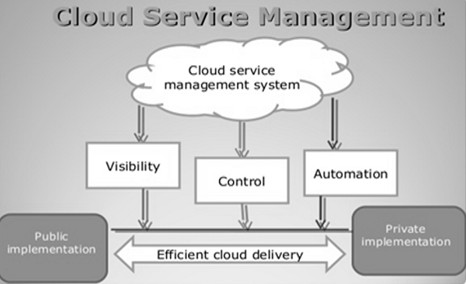
The purpose and scope of the management of cloud services are listed below:
•Purpose: Establish suitable techniques for managing and running cloud-based services. Insert cloud service management techniques into current frameworks for IT creation and support.
•Scope: Oversight of cloud-based service design, development and change. Cloud-based service management and operation.

Slide 44
Characteristics of Cloud Service Management
In a design for handling cloud environments, cloud management incorporates applications and technologies.
In the following categories, cloud-management systems and instruments should be able to have minimum functionality.
Service request: receiving and fulfilling user requests to access and deploy cloud services.
Cost management and optimization: Cloud spending monitors and accurate sizes and aligns resources and efficiency with real demand.
Security and compliance: handling cloud providers' role-based access and implementing security settings.
Inventory and classification: discover and maintain pre-existing cloud infrastructure in the brownfield plus track and handle modifications.

Slide 45
Cloud Ecosystem? 2M
A cloud ecosystem is a complex system of interdependent components that all work together to enable cloud services. In cloud computing, the ecosystem consists of hardware and software as well as cloud customers, cloud engineers, consultants, integrators and partners.
How a cloud ecosystem works
The center of a cloud ecosystem is a public cloud provider. It might be an IaaS provider such as Amazon Web Services (AWS) or a SaaS vendor such as Salesforce. Radiating out from the center of the cloud are software companies that use the provider's anchor platform, as well as consultants and companies that have formed strategic alliances with the anchor provider.
Benefits
To build new business models.
for example, to launch a heart-monitoring service on its cloud service provider's cloud infrastructure and then sell the service alongside its main business of manufacturing heart monitors for hospitals
To aggregate data and analyze how each part of the system affects the other parts. For example, if an ecosystem consists of patient records, smart device logs and healthcare provider records, it becomes possible to analyze patterns across an entire patient population.

Slide 46
Actors and Roles of a Cloud ecosystem 4M
1.Cloud service users (CSU),
2.Cloud service providers (CSP),
3. Cloud service partners (CSN).
Cloud service provider (CSP):
Provider of SaaS and/or CaaS and/or
PaaS and/or IaaS and/or NaaS
Inter-cloud:
Inter-cloud peering,
Inter-cloud service broker,
Inter-cloud federation
2.Cloud service user (CSU):
Consumer,
Enterprise (including enterprise administrator),
Governmental/public institution
3. Cloud service partner (CSN):
Application developer,
Content provider,
Software provider,
Hardware provider,
Equipment provider,
System integrator,
Auditor

